Slide 1
Capstone Project
Tessa Check, Matthew Pivoney

Slide 2
Intro
IALU - annual event for Lasallian educators held in Rome
Mission - mobile app to be central point of Lasalle resources
Roles:
Tessa: Navigation Drawer and links to resources
Matthew: LS Talks and News Feed (RSS)

Slide 3
Demo
-Hierarchy
-LS Talks

Slide 4
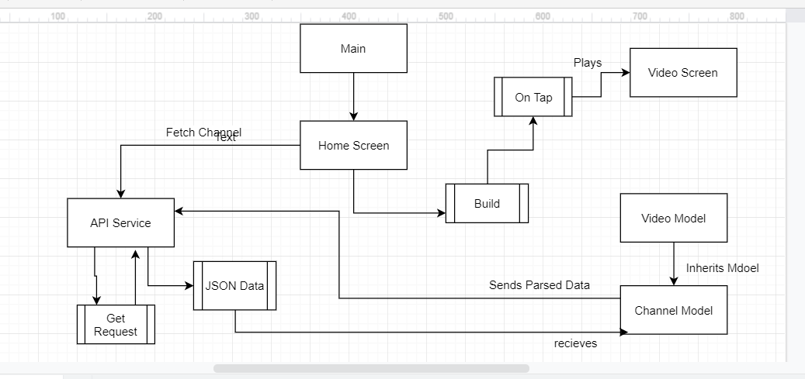

Slide 5
Object oriented concepts
Class APIService= singleton, to keep track of next page token
Encapsulation/Abstraction/Inheritance - Objects in their own separate file and are called upon in main.dart
Notes:
singleton class is a class that can have only one object (an instance of the class) at a time. After first time, if we try to instantiate the Singleton class, the new variable also points to the first instance created. So whatever modifications we do to any variable inside the class through any instance, it affects the variable of the single instance created and is visible if we access that variable through any variable of that class type defined.

Slide 6
Soft libs / framework
Language - Dart using the Flutter framework
?? , Future
Import ‘package/flutter/material.dart’
‘path/targetFile.dart’
‘package/url_launcher/ur_launcher.dart’
‘package/http/http.dart’
Pubspec.yaml - dependencies : http, youtube_player_flutter, url_launcher, webfeed
Assets: - src/target
Notes:
?? = nul aware operator, returns operator on left unless expression is null, in which case expression on right is used
Future = asynchronous code that acts like try / catch synchronous block
flutter/material.dart = widget building blocks for dart
path/target.file = how to import a file to another file to use its variables
Url_launcher = opens browser
Dep:
http - allows us to send request to api/web to get data
Youtube_player_flutter- youtube player api, helps with parsing / formating
Url_launcher - open browser
Web_feed - plugin to parse feed
Assets: how to add stuff from your computer to go on app, like pictures

Slide 7
Improvements that could be made
Quality of life features
Accessibility features (audio for the blind)
RSS reader could have thumbnails
Instead of youtube api, make a grid (Chewie?)
Home screen could have logo, important news, alert for updates, etc

Slide 8
Problems and Successes
Problems
- Unfamiliar language, no mobile app experience, lack of communication, visually unappealing, unfinished,
Successes
Youtube API works, RSS Feed generated through google news,

Slide 9
Software Tool / Key modules
https://flutterstudio.app/ - fast way to get a feel for flutter development
Key modules: Hierarchy(main.dart) / homescreen.dart / RSSNews.dart

